Slide 1
Power BI Dashboard – Sales Analysis
Interactive Dashboard with KPIs, Trends, Segments, and Geography
By:- Kunj Aghera

Slide 2
Objective
To build a comprehensive dashboard using Power BI for analyzing sales performance across time, regions, segments, and product categories using visual KPIs and insights.

Slide 3
Dataset Summary
The dataset includes order-level sales data with fields such as:
- Order ID, Order Date, Sales, Segment, Product Name
- Region, City, Category, and Product Sub-Category
- Enables multi-dimensional business analysis

Slide 4
KPI: Total Sales and Orders
Total Sales of ₹2.26M indicates strong revenue generation.
This KPI offers a high-level view of overall business performance.
Over 9800 orders processed.
This reflects high transaction volume and sustained demand.

Slide 5
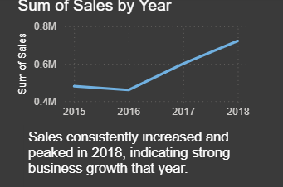
Sales Trend by Year
Sales consistently increased and peaked in 2018, indicating strong business growth.
Line chart reveals upward trend and seasonal insights.

Slide 6
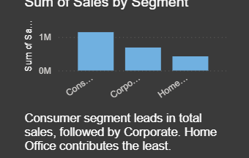
Sales by Segment
Consumer segment leads in total sales, followed by Corporate.
Home Office contributes the least among segments.

Slide 7
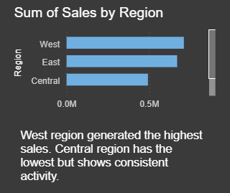
Sales by Region
West region generated the highest sales.
Central region shows consistent sales, though relatively lower.

Slide 8
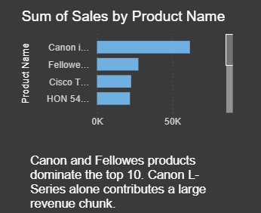
Top Products by Sales
Canon and Fellowes products dominate the top-selling list.
Canon L-Series alone contributes a large revenue chunk.

Slide 9
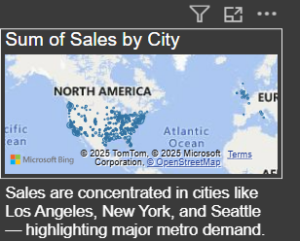
Sales by City (Map)
Sales are concentrated in cities like Los Angeles, New York, and Seattle—highlighting metro demand.
Geographic map helps identify regional focus areas.

Slide 10
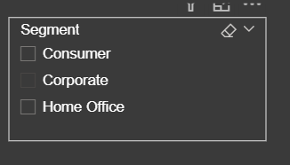
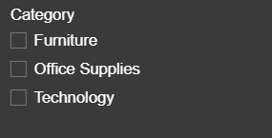
Filters and Slicers
Users can filter the report by Segment, Category, and Region.
Slicers provide interactivity for deeper exploration of sales patterns.

Slide 11
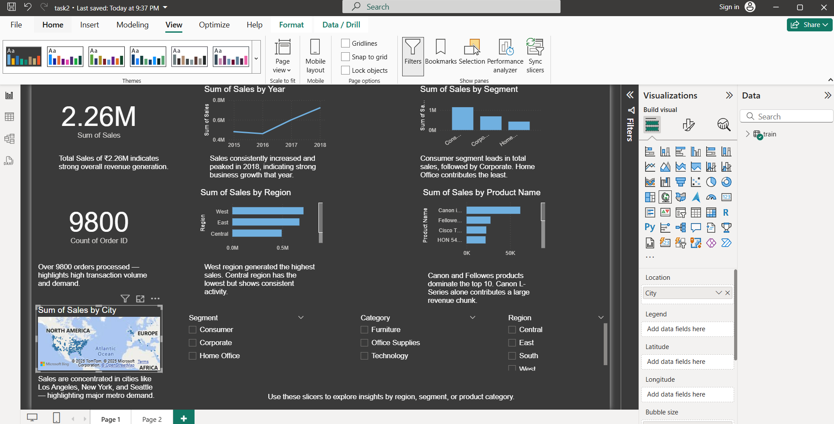
Screenshot of dashboard

Slide 12
Conclusion and Key Insights
- Total revenue and order volume show strong business performance
- Consumer segment dominates sales
- Western region and metro cities contribute the most
- Dashboard enables dynamic analysis and supports business decisions

